Slide 1
Interop SharePoint and Exchange Protocol Test Suites

Slide 2
Overview
Test Suites are designed to verify that the server behavior is in compliance with normative protocol requirements in the technical specifications. Test suites focus on the man-in-the-middle (manipulation of protocol traffic) and server replacement scenarios.
In a single test suite, similar or related requirements are grouped into one test case. Test cases on the same command or operation are grouped into one scenario.

Slide 3
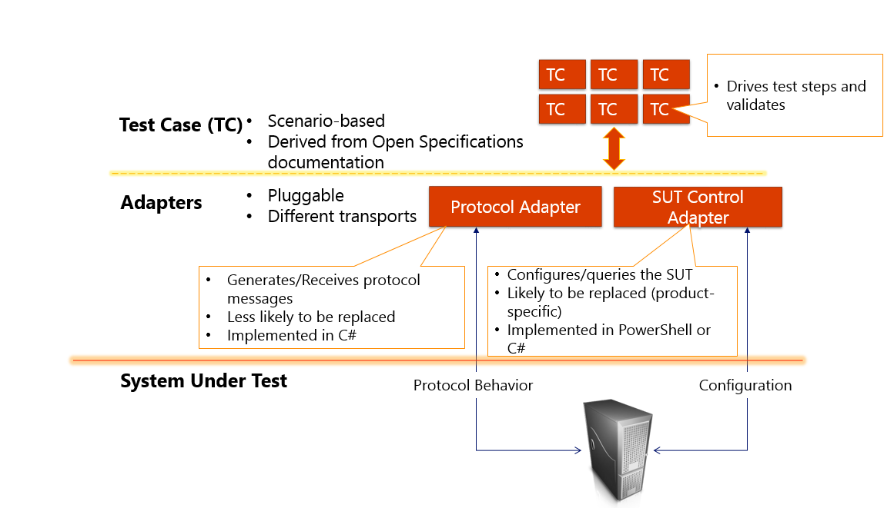
The high-level design of a test suite

Slide 4
Test suite directories
A SharePoint or Exchange Protocol test suite folder mainly consists of the following:
Docs: Docs on deployment, test suite specification, and requirement specification spreadsheet (a list of normative requirements extracted from the technical document for each protocol associated with the test suite).
Setup: Configuration scripts and resources (both client and server-side) for setting up the test suite environment.
Source: Test suite source code and scripts.

Slide 5
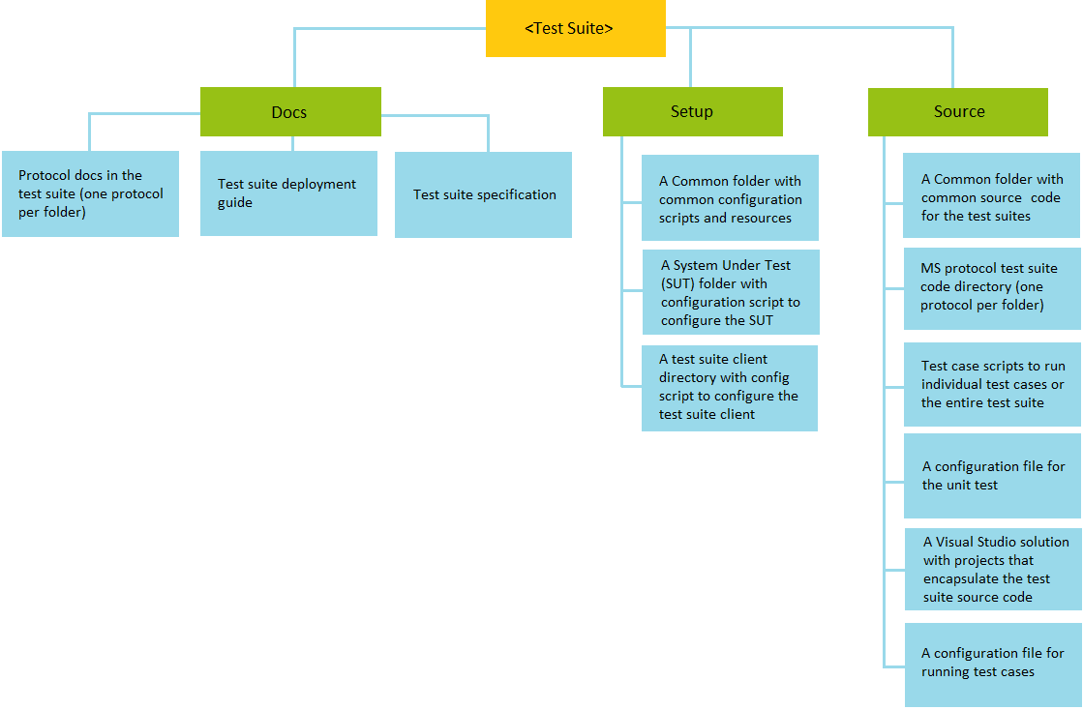
Interop test suite folder structure and its content

Slide 6
Test environment for the test suites
Machine name | SharePoint test suite environment | Exchange test suite environment
SUT | Microsoft SharePoint Sever 2013/2010/2007 | Microsoft Exchange Server 2016/2013/2010/2007
Client | Microsoft Visual Studio 2013 Ultimate | Microsoft Visual Studio 2013 Ultimate
 | Protocol Test Framework | Protocol Test Framework
Optional | Microsoft Network Monitor and Parsers or Message Analyzer | Microsoft Network Monitor and Parsers or Message Analyzer

Slide 7
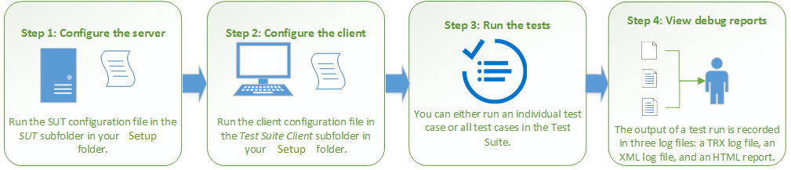
Workflow

Slide 8
Thank you

